Slide 1

Term Project for Big Data Mining and Application
Title: Anomaly Detection using Apache Spark
Advisor: Prof. J. H. Wang
Prepared by:
Direselign Addis-106999405
Zewdie Mossie Erukneh-106999403
June 2018

Slide 2
Content
Introduction
Intrusion Detection
Dataset
Proposed method
Experiment Setup
Data analysis and result
Summary

Slide 3
Introduction
The increase in the size of networks and the data massively produced by them has made the data analysis very challenging
So it becomes even more difficult to detect intrusions in the case of big data.
In this era, the experts find very limited tools and methods to analyze big data for security reasons.
Either need to device new tools or use existing tools in a novel manner to achieve the purpose of big data security analysis.
In this project, we use apache spark a big data tool for analyzing the big dataset for anomaly detection.

Slide 4
Cont.…
The anomaly detection performed after some preprocessing and then
Random forest and Kmeans clustering are used
The main objective of this project is to analyze the dataset using MAP and REDUCE
We also check machine learning algorithm in the context of anomaly detection
In this regard, we set to compare their training time, prediction time, and the rate of accuracy.
The analysis implemented on NLS-KDD version of Kddcup99 dataset available for research.
Although this dataset is of size in megabytes but it meets our purpose here for big data security analytics as we have seen in our homework.

Slide 5
Intrusion Detection
Network intrusions detection protects a computer network from unauthorized users
Both insider and outsides
The intrusion detector learning task is to build a predictive model (i.e. a classifier) capable of distinguishing between
bad connections(intrusions or attacks) and good or normal connections.
A connection is a sequence of TCP packets starting and ending at some well-defined times
Each connection is labeled as either normal, or as an attack, with exactly one specific attack type.

Slide 6
Dataset
Attacks fall into four main categories:
DOS: denial-of-service
R2L: unauthorized access from a remote machine
U2R: unauthorized access to local superuser (root) privileges
Probing: surveillance and other probing, e.g., port scanning.
It is a widely used dataset by the research community in network security.

Slide 7
Cont.…
The dataset has 125, 973 instances in training and 22, 544 instances in test dataset and these instances contain 41 features.
It contains different types of attacks which are about 38 in training and 28 in testing dataset.
The dataset was generated in MIT Lab
It was produced by processing the tcpdump portions of DARPA IDS evaluation dataset.
Data Types of the dataset
Nominal-----3 columns
Binary------ 6 columns
Numeric----32 column

Slide 8
Proposed Method
In the proposed model, the dataset analyzed for security analytics which is stored in the local machine.
The dataset is loaded using apache spark.
After loading the data, it undergoes the data standardization process.
In the project, normalization is done by using the common techniques of MinMax, average and others
After the normalization process the data analyzed for anomaly detection using selected machine learning algorithms.
The whole process is depicted by model as shown in next slide.

Slide 9
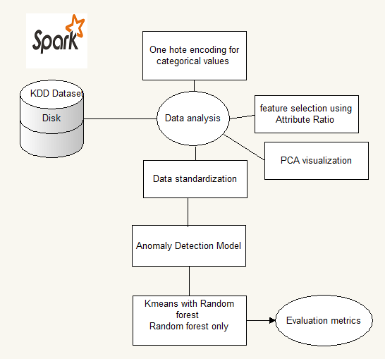
Proposed Architecture
Cont.…

Slide 10
Experiment setup
HP desktop with Ubuntu 18.04 OS
24 GB RAM
Apache spark 2.3.0 Open source Distributed computing platform
Standalone Apache spark is configured in the computer with two nodes.
Algorithm parameters
Kmeans- k=8, intialstep=25, maxiter=100
Random forest-numberTree=500, MaxDepth=20

Slide 11
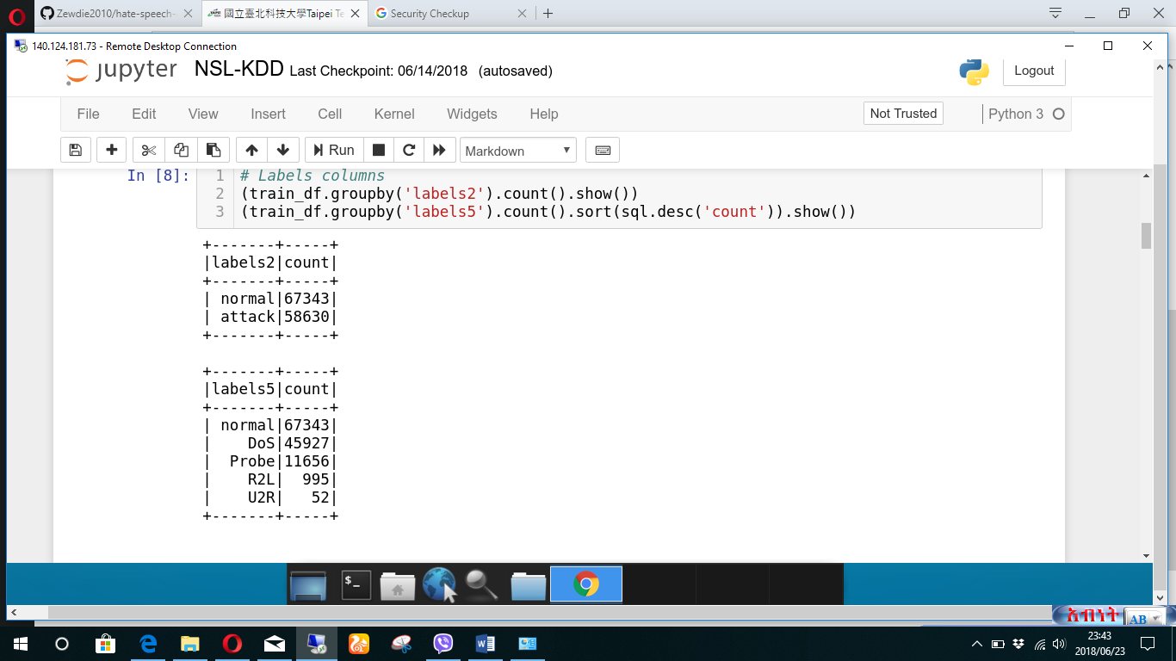
Data preparation(part 1)
Training data Testing data

Slide 12
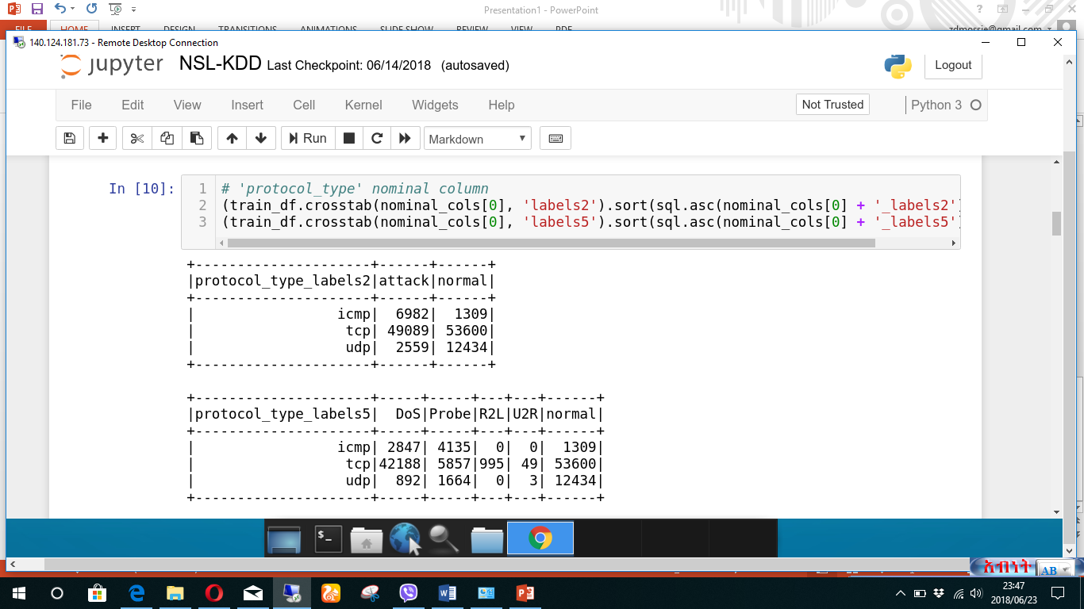
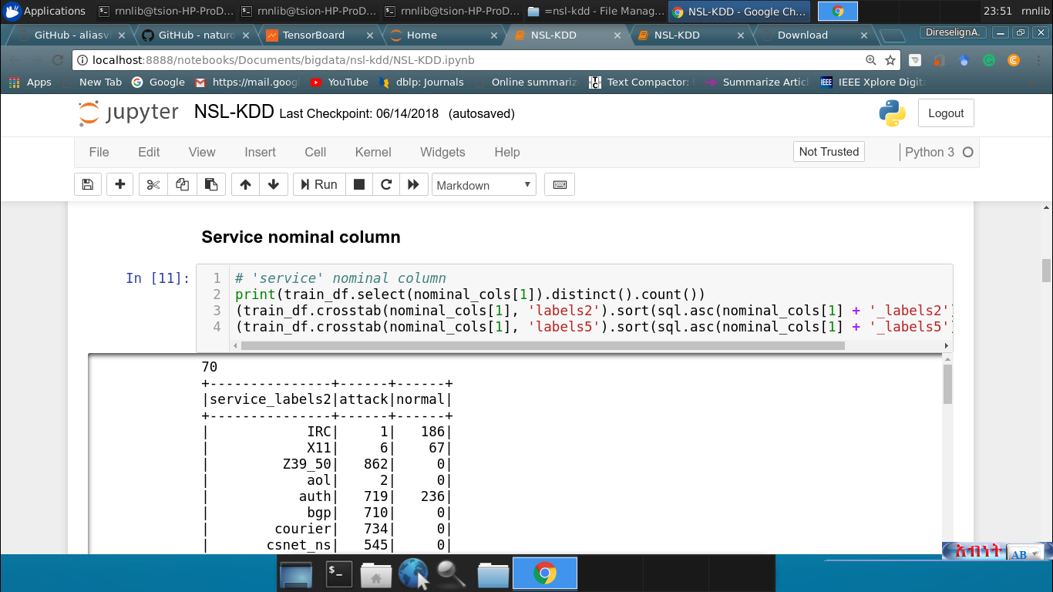
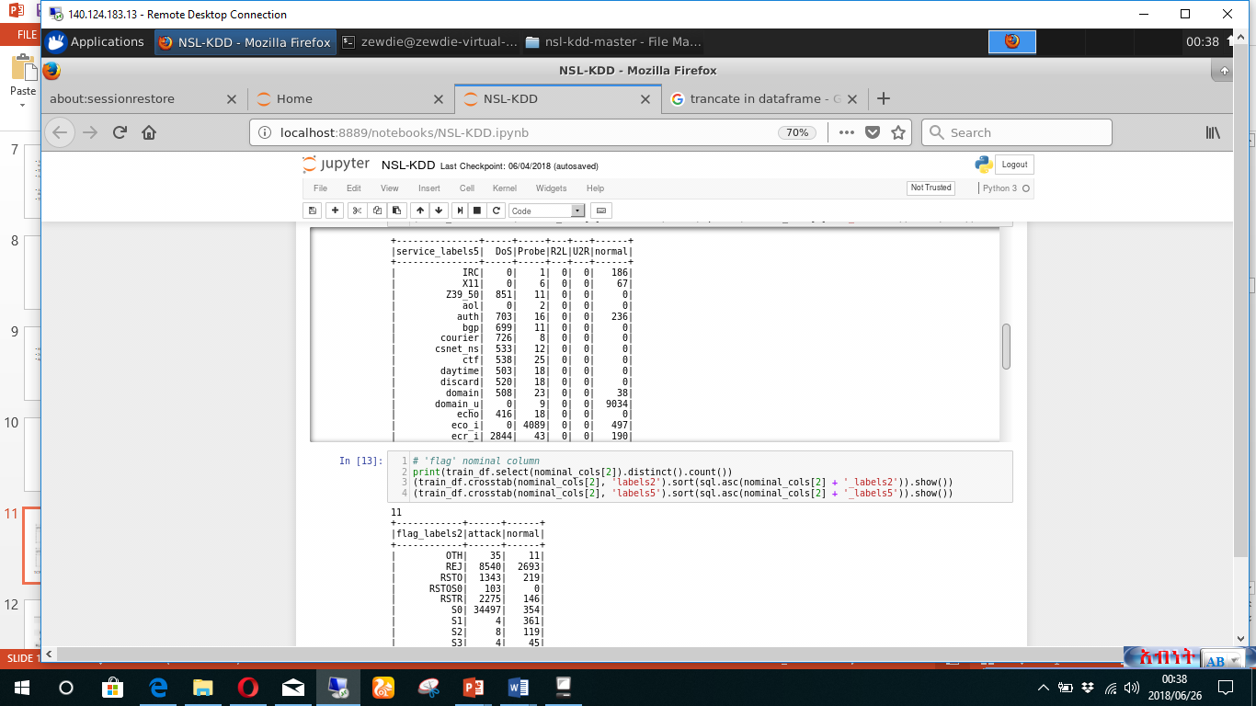
TCP nominal column Service nominal column
Cont.…

Slide 13
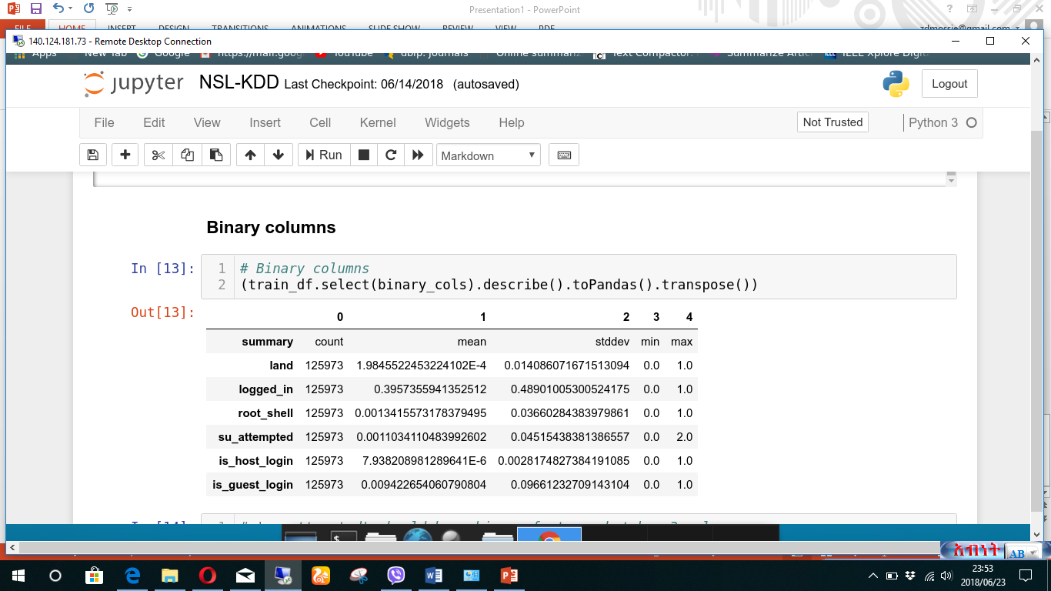
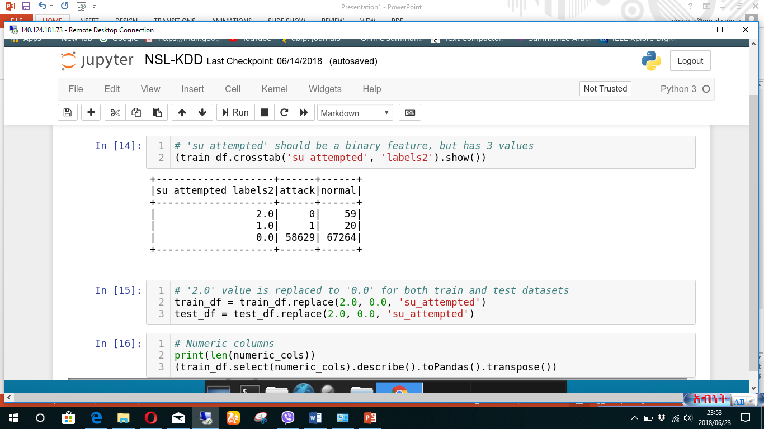
Cont.….
Binary column Replacing Non-Binary values

Slide 14
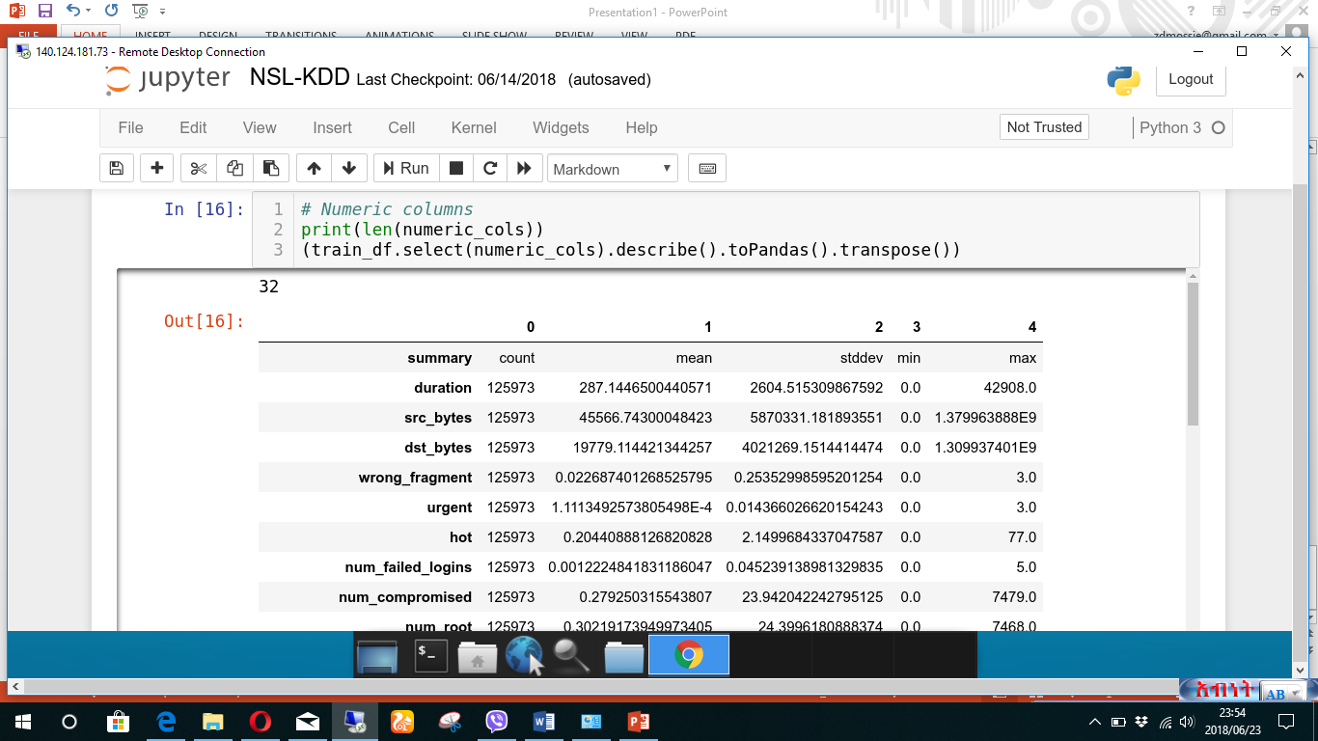
Numeric columns
Cont.…

Slide 15
One Hot encoding
Machine learning algorithms cannot work with categorical data directly.
Categorical data must be converted to numbers
A one hot encoding which is a representation of categorical variables as binary vectors is used

Slide 16
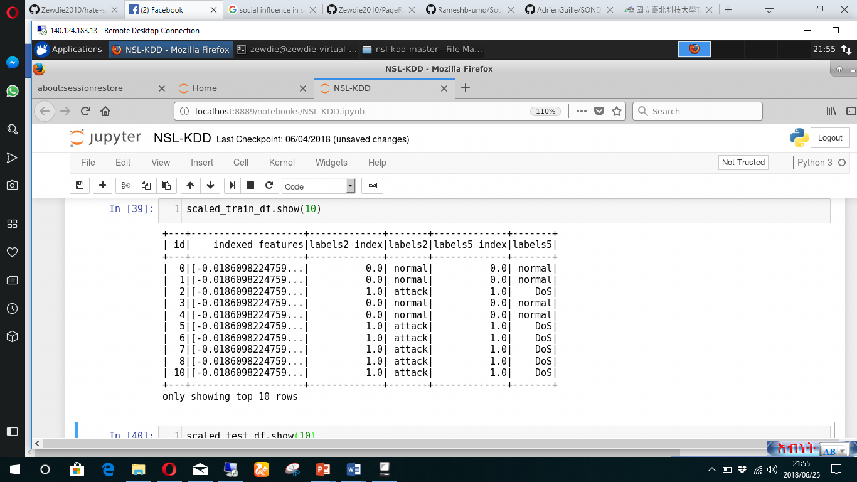
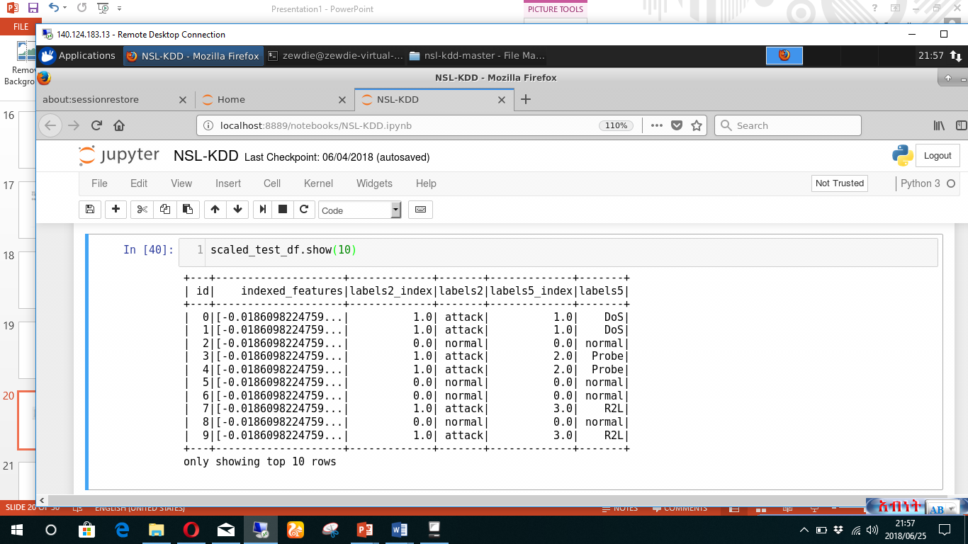
Data preparation(part 2)
Machine learning algorithms make assumptions about the dataset modeling.
Often, raw data is comprised of attributes with varying scales
Training data Testing Data

Slide 17
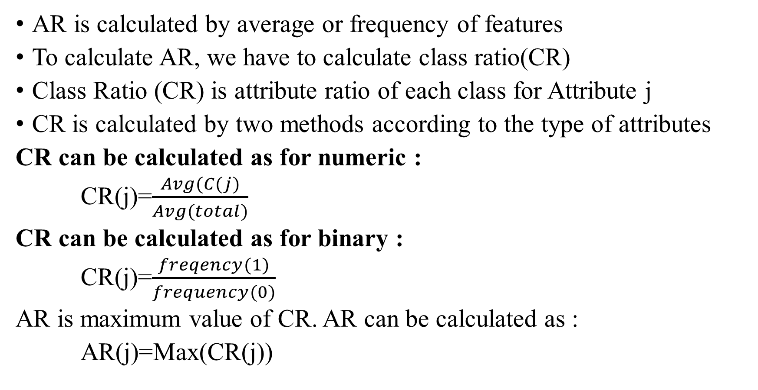
Feature selection using AR
AR is calculated by average or frequency of features
To calculate AR, we have to calculate class ratio(CR)
Class Ratio (CR) is attribute ratio of each class for Attribute j
CR is calculated by two methods according to the type of attributes
CR can be calculated as for numeric :
CR(j)=$\frac{Avg(C(j)}{Avg(total)}$
CR can be calculated as for binary :
CR(j)=$\frac{freqency(1)}{frequency(0)}$
AR is maximum value of CR. AR can be calculated as :
AR(j)=Max(CR(j))

Slide 18
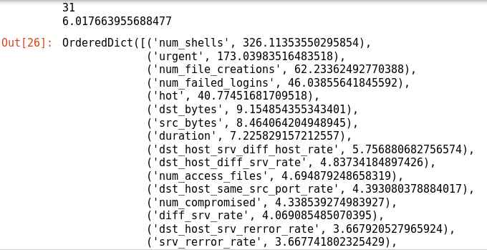
Cont.…
Sample AR result

Slide 19
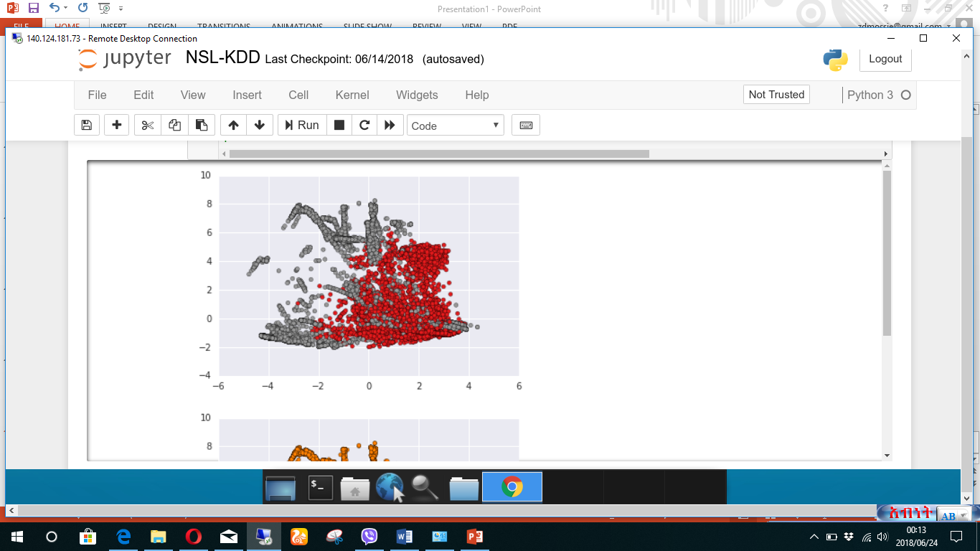
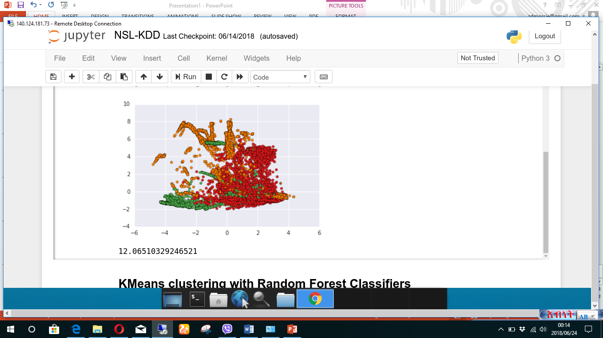
Attack vs Normal 4 Attack vs Normal
Visualization Using PCA

Slide 20
Evaluation metrics
To evaluate the performance result the following metrics were used
Accuracy
AUC
False Alarm Rate
Detection Rate
F1 score
Precision
Recall

Slide 21
KMeans Clustering
Cluster data and then train with Random forest classifier for each of the clusters and predict with new dataset
Clusters are splited into two categories
Frist category contains clusters that have both 'attack' and 'normal' connections and have more than 25 connections
Second category contains all other clusters and maps cluster to 'attack' or 'normal' based on majority
All clusters that contains less or equal than 25 connections are treated as outliers and are mapped to 'attack' type.

Slide 22
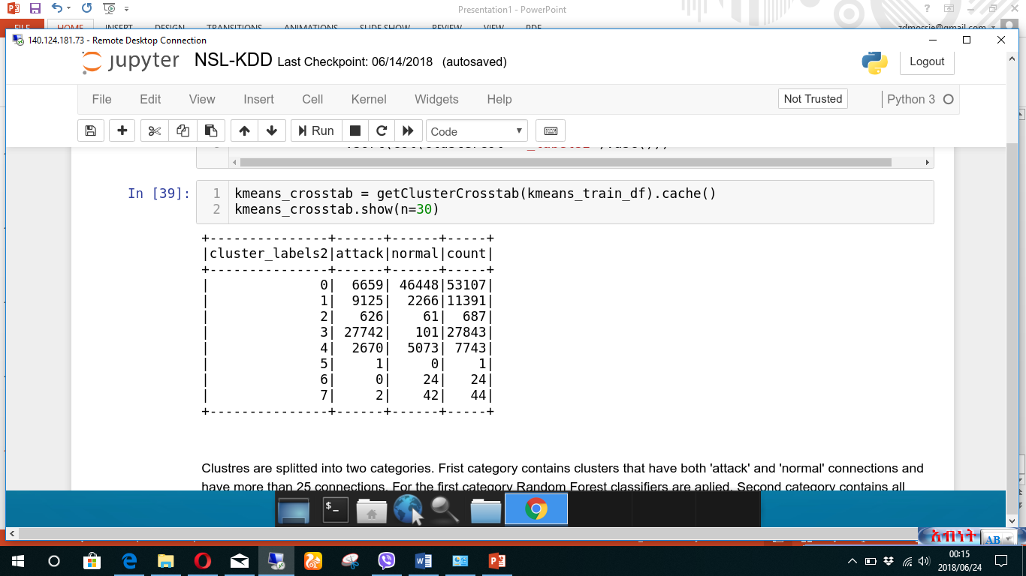
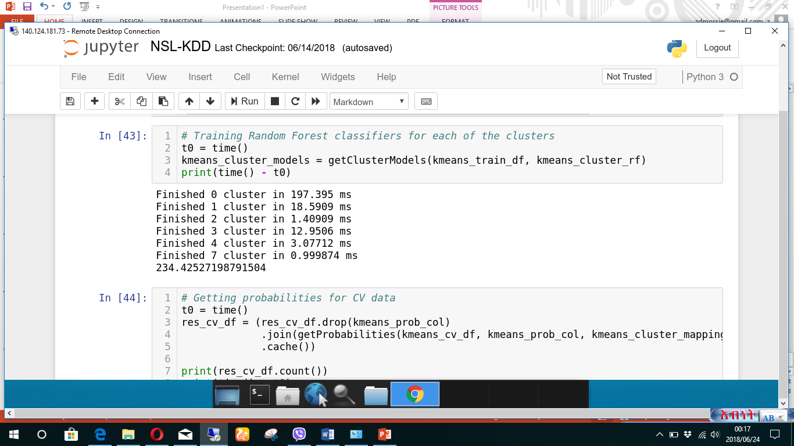
Cont.…

Slide 23
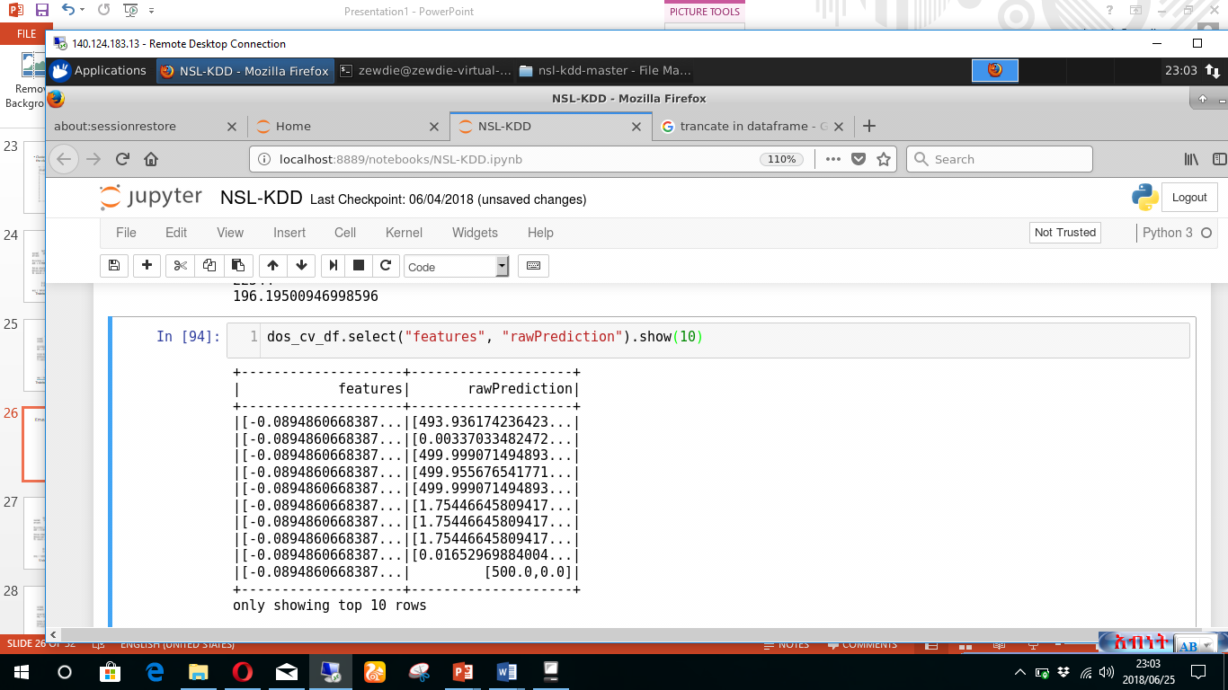
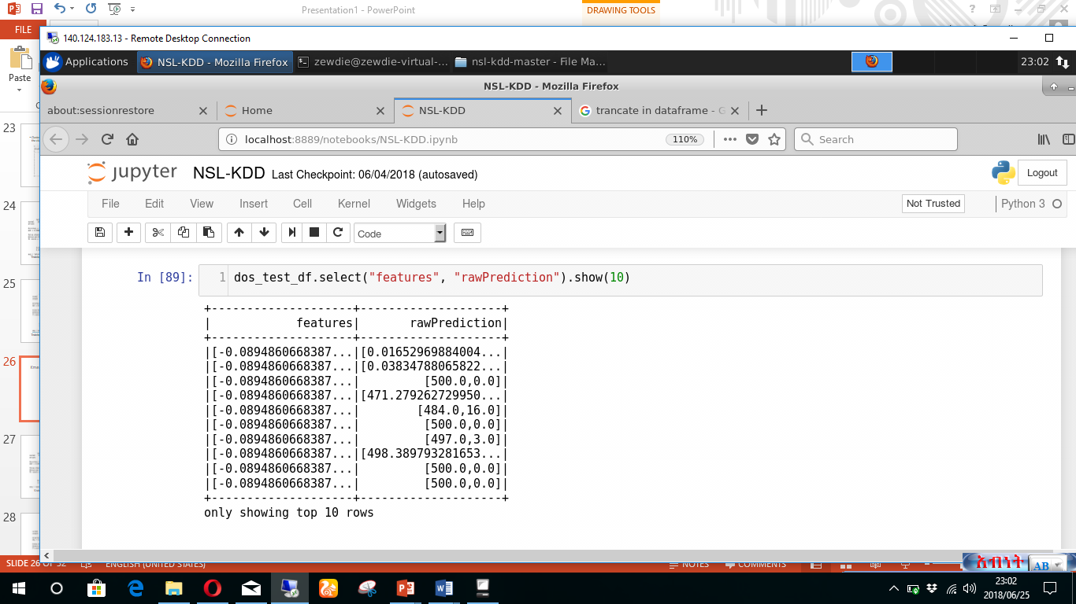
Features after AR
CV data Test data

Slide 24
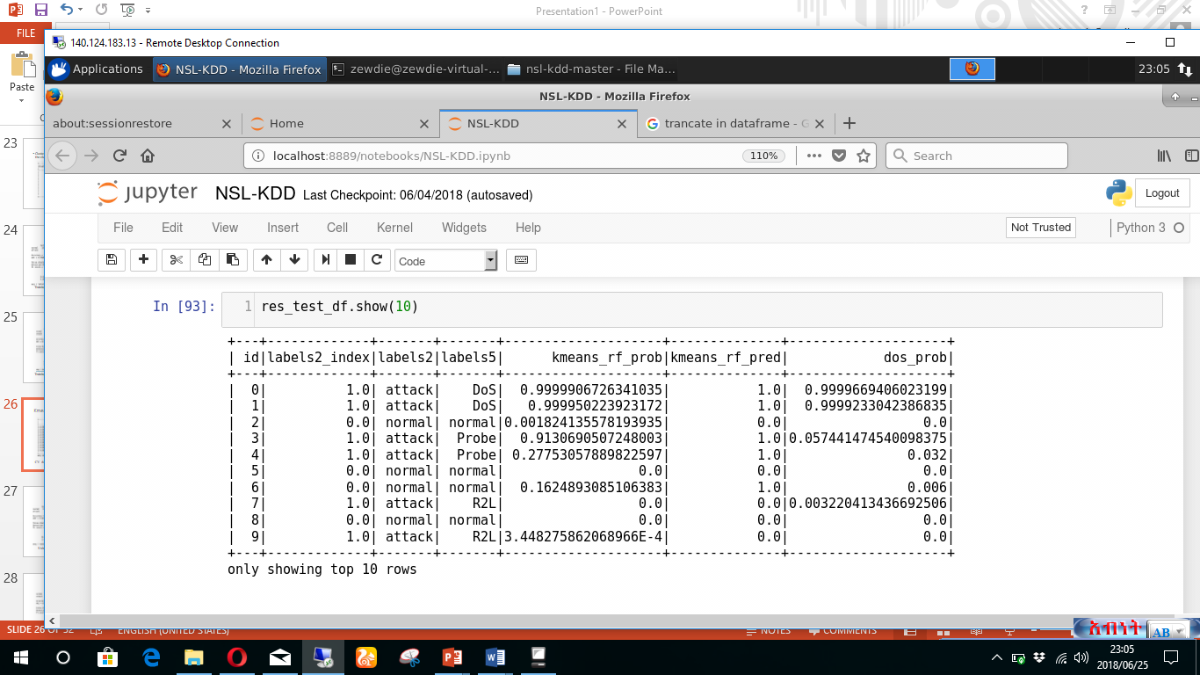
Detecting each type of attack(DOS sample)

Slide 25
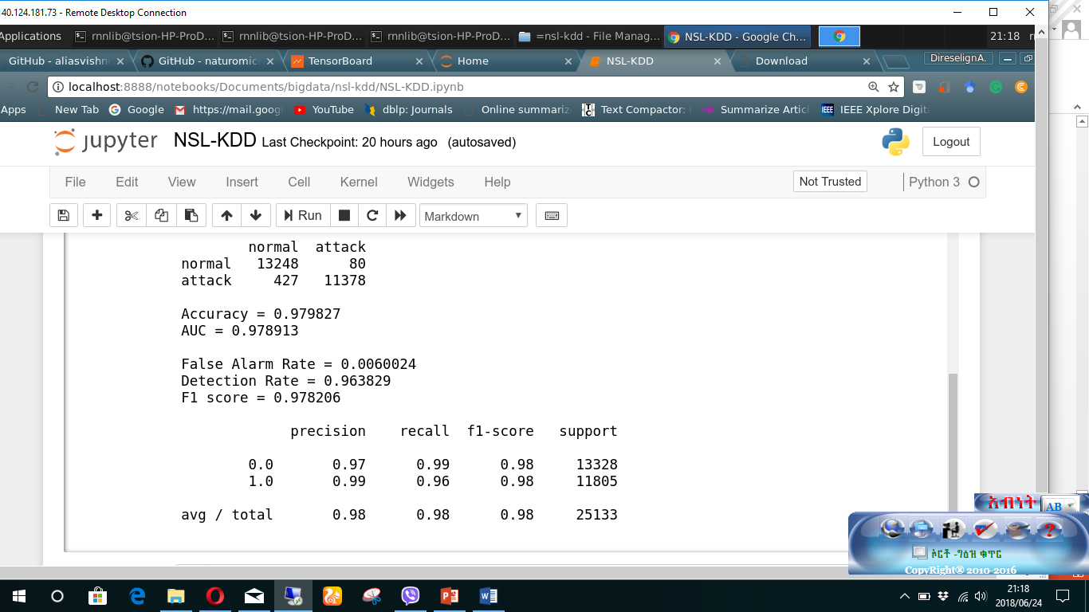
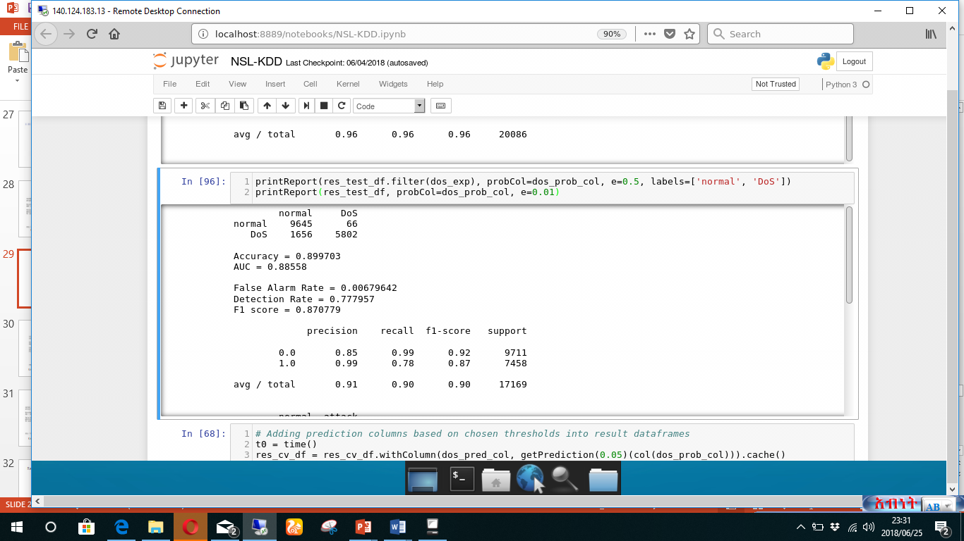
Using AR Using the whole data
Cont.…
Normal Vs DOS

Slide 26
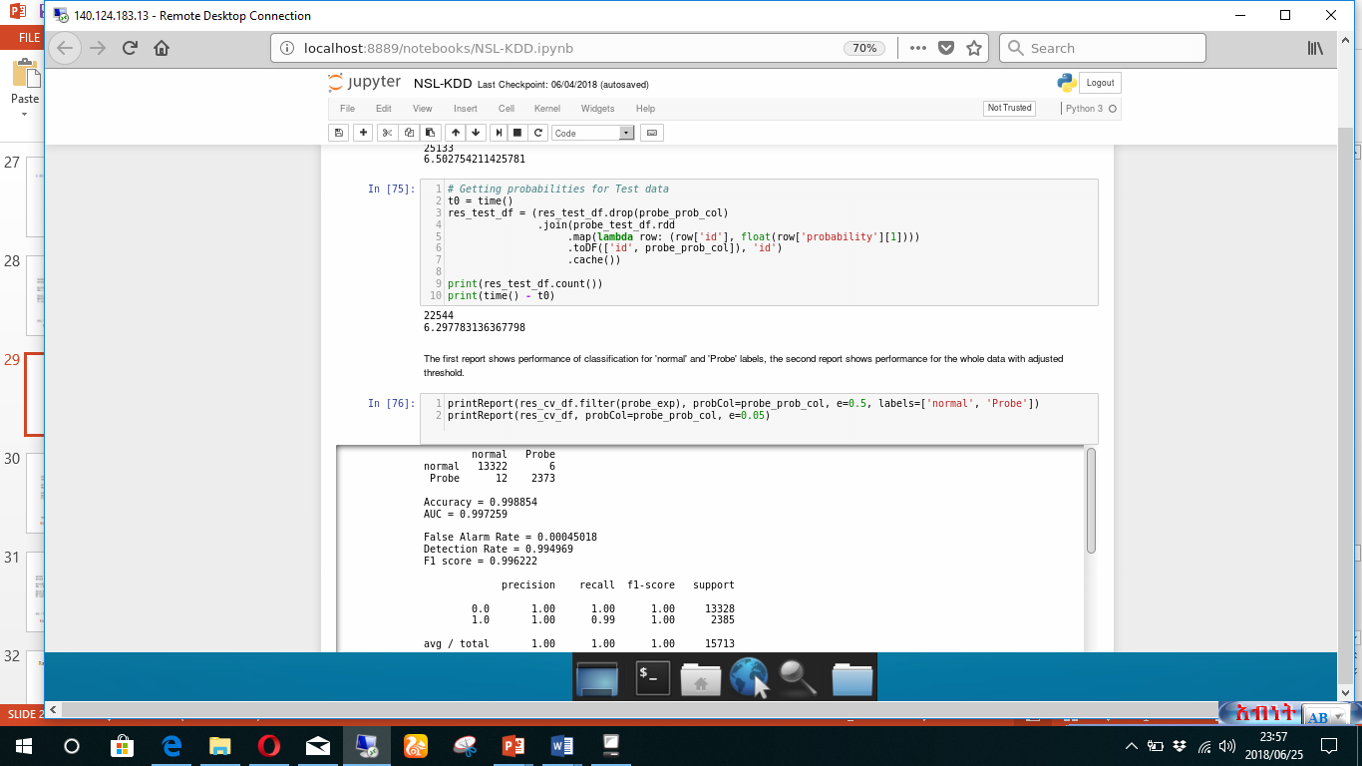
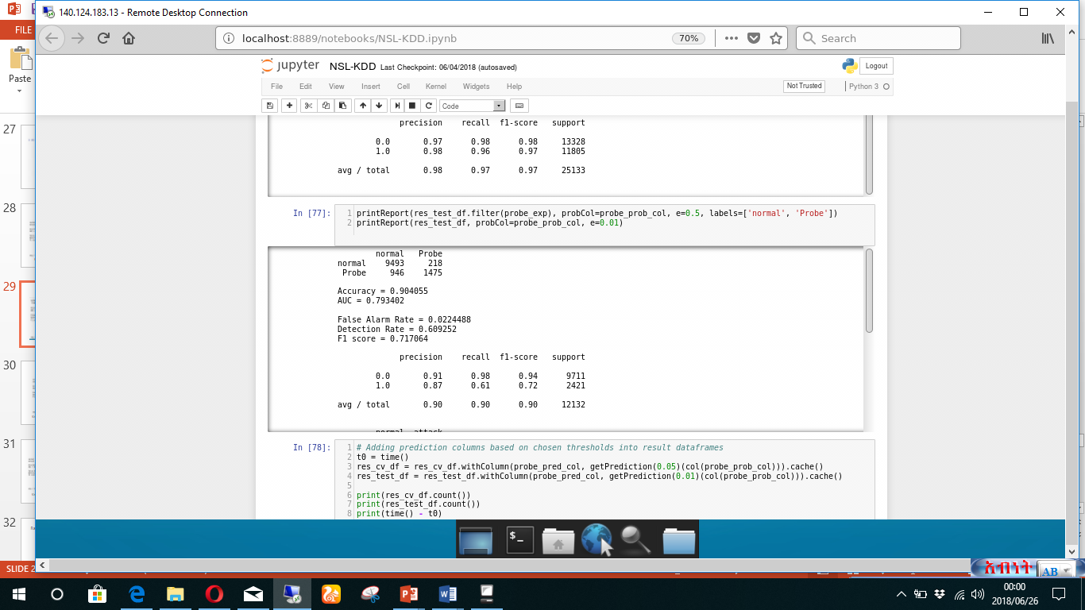
Cont.… Prob and Normal
Using AR Using the whole data

Slide 27
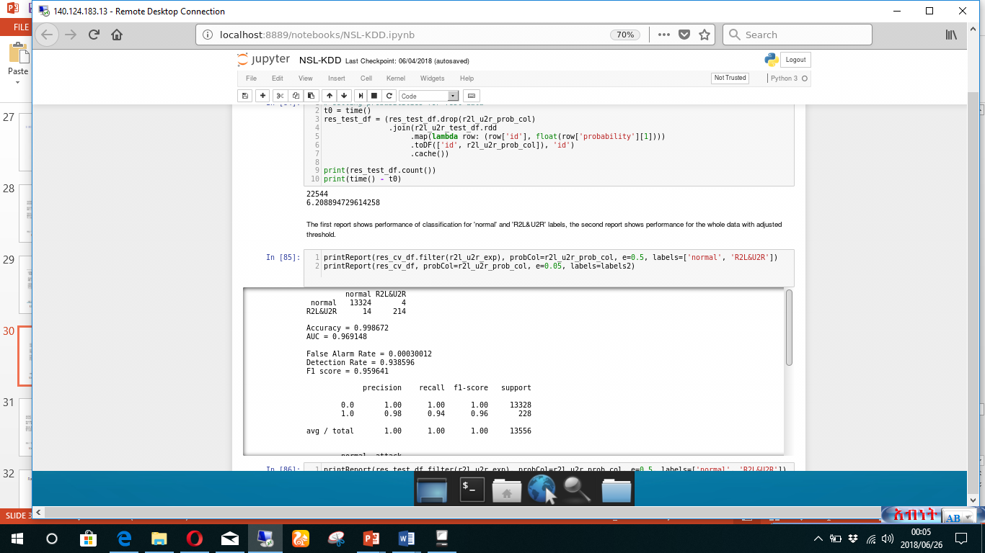
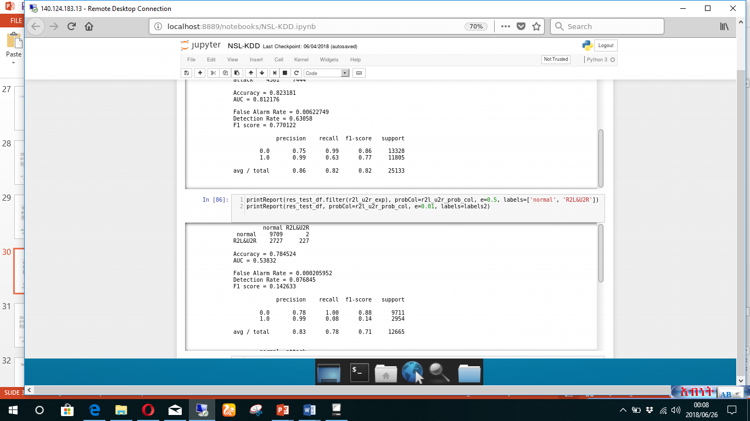
Cont.… Normal vs U2R and R2L
Using AR Using the whole data

Slide 28
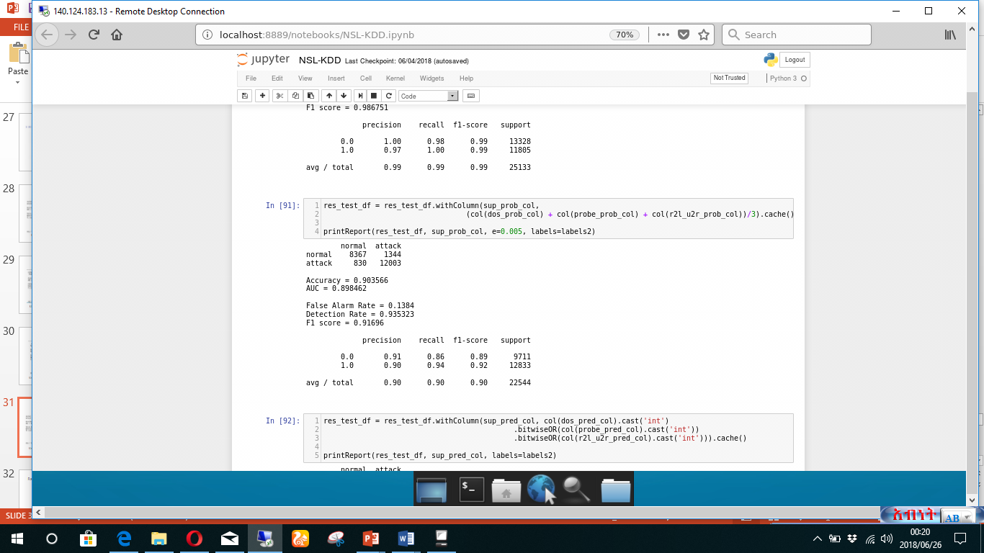
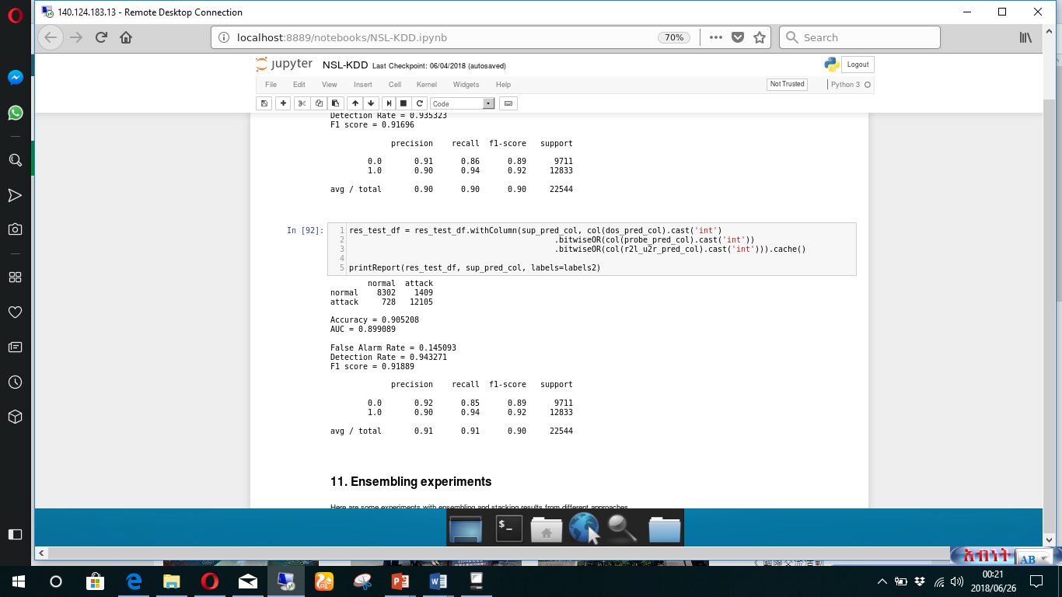
Combined Results
Using AR Using the whole data

Slide 29
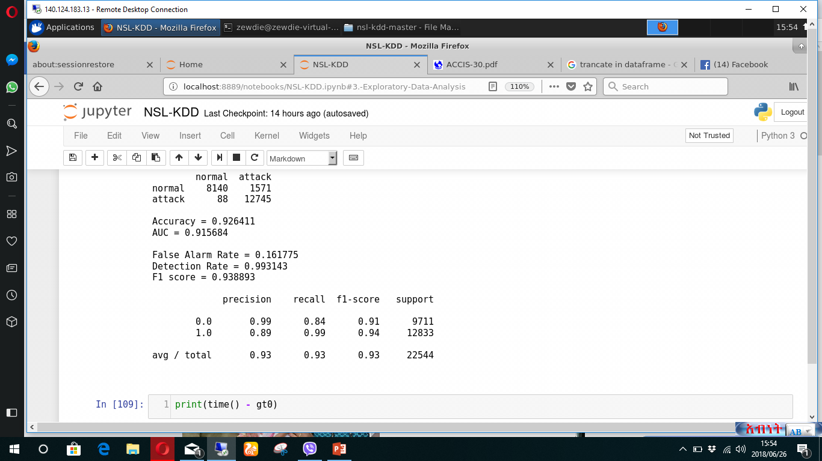
Only Random forest using AR
Cont.…

Slide 30
Summary Result
The best result from was achieved by KMeans Clustering with Random Forest Classifiers
When the AR feature selection is used
It gives around ~98-99% of detection rate with reasonable ~14-15% of false alarm rate and F1 score of 0.94
The computing time is also efficient in all aspects

